Slide 1

Introduction to
Object Oriented Programming
in Java
Notes:
Scary title, but dont worry.
Previous expericence with Study Jam

Slide 2
Udacity - Intro to Java Programming
Classes vs Objects
Fundamental Data Types
Making decisions in your programs
Basic Algorithms
Link: https://www.udacity.com/course/intro-to-java-programming--cs046
And It’s Free ! :)

Slide 3
Agenda for today
Programming with Objects
Classes vs Objects
Methods that define behaviour
Variables that define state
Families of Objects or so called Inheritance

Slide 4
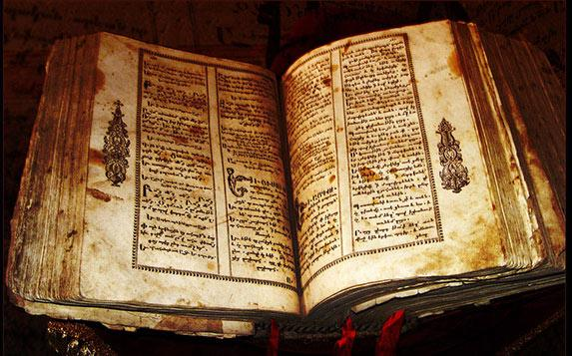
Programming is Black Magic isn’t it?

Slide 5
Misconceptions about Programming
Programming is NOT:
Hacking that we know from films
Quick typing
Writing 0’s and 1’s into the console
A career path only for geeks

Slide 6
What Programming is?
“Computer programming is a process that leads from an original formulation of a computing problem to executable computer programs.
Programming involves activities such as analysis, developing understanding, generating algorithms, verification of requirements of algorithms including their correctness and resources consumption, and implementation of algorithms in a target programming language.”
Definition from Wikipedia
Notes:
That’s why we still think it is black magic

Slide 7
What Programming really is?
“Programming is a creative process done by programmers to instruct a computer on how to do a given task.”
About.com
Notes:
Creative, because it requires thinking
Process, because it’s usually iterative (it takes time to build a program that does what users expect it to do)
Intructing a computer - this means, we, the programmers we need to talk to the computer in such a way it understands what it has to do. There is not magic there, the computer will do exactly what you have written it to do and nothing more and nothing less.

Slide 8
Programming examples
Writing a small formula in Excel or other spreadsheet program:
= SUM(A1:A3) - B1
Writing a small search filter in your inbox:
from:k4rolina.kafel and filename:pdf
Changing a way an image should be scaled inside an ImageView:
android:scaleType="centerCrop"

Slide 9
Object Oriented Programming
“Object-oriented programming is a programming paradigm based on the concept of "objects", which may contain data, in the form of fields and code, in the form of methods (...) In OOP, computer programs are designed by making them out of objects that interact with one another.”
Definition from Wikipedia
Notes:
Scary definition first

Slide 10
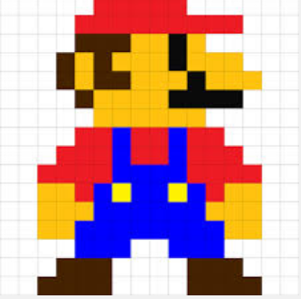


Object Oriented Game
Player
Monster1
Monster2
Reward
kills
drops
Monster3

Slide 11
Object Oriented Game
Reward1
Player
Monster1
Monster2
Reward2
kills
drops
Monster3
Reward3

Slide 12
OO Game - Classes will save your day!
And some typing as well...
Player
Monster
Reward
kills
drops
Think of Classes as blueprints of Objects.
One Class can be used to create as many Objects as you want*.

Slide 13
Designing a Class
Knows or Has:
- name
- location
- number of coins collected
- visual asset
Does:
- move()
- jump()
- collectCoin()
Player

Slide 14
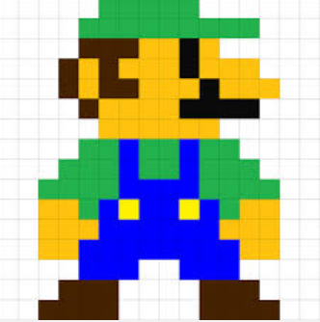
One Class but multiple Objects
Knows or Has:
- name
- location
- number of coins collected
- visual asset
Does:
- move()
- jump()
- collectCoin()
Player1
Player2
name: Mario
location: Castle
coins: 31 coins
name: Luigi
location: Sewers
coins: 13 coins

Slide 15
Structure of a Class
Source file
Class
- Variable 1
- Variable 2
Method1
Statements...
Method2
Statements...

Slide 16
Structure of a Class
public class Player {
private String name;
private int numberOfCoins;
public Player(String name) {
this.name = name;
}
public void collectCoin() {
numberOfCoins = numberOfCoins + 1;
}
}
Class

Slide 17
Structure of a Class
public class Player {
private String name;
private int numberOfCoins;
public Player(String name) {
this.name = name;
}
public void collectCoin() {
numberOfCoins = numberOfCoins + 1;
}
}
variables
constructor
Class
method

Slide 18
Structure of a Class
public class Player {
private String name;
private int numberOfCoins;
public Player(String name) {
this.name = name;
}
public void collectCoin() {
numberOfCoins = numberOfCoins + 1;
}
}
variables
constructor
Class
statement
statement
method

Slide 19
Structure of a Class
Variables:
define state of an object
examples: player name and number of coins
Methods:
define behaviour of an object, which could also mean changing a its state by modifying variables
examples: collectCoin()

Slide 20
Mysterious Constructor
Constructor is a special type of method, that is used to create new objects from a given class blueprint.
Monster1
Monster2
Monster3
Monster monster1 = new Monster();
Monster monster2 = new Monster();
Monster monster3 = new Monster();
Player
Player player = new Player("Mario");

Slide 21
Calling Methods
To call a method, we need an object.
Player player = new Player("Mario");
player.collectCoin();
It is also possible to pass an argument to a method.
player.collectCoin(2);

Slide 22
Few words about Inheritance
Monster1
Things in common:
variable: location
variable: visualAsset
Method: move()
Method: jump()
Things that are different:
No name in a Monster
No numberOfCoins variable in Monster
No collectCoin() method in Monster
Player

Slide 23
Inheritance solves problems
Sprite
Implemented once in Sprite:
variable: location
variable: visualAsset
Method: move()
Method: jump()
Monster1
Player

Slide 24
Inheritance in code
Declaration:
Usage:
Player player = new Player("Mario");
player.collectCoin(); // from Player
player.move(); // from Sprite
public class Player extends Sprite {
// all previous code remains here…
}
Inheritance is an IS-A relationship between objects

Slide 25


IS-A Relationship
OK!
Cat cat = new Cat();
Dog dog = new Dog();
Animal
OK!
Animal cat = new Cat();
Animal dog = new Dog();
?
Cat
Dog
Cat cat = new Animal();
Dog dog = new Animal();

Slide 26
IS-A Relationship
OK!
Cat cat = new Cat();
Dog dog = new Dog();
Animal
OK!
Animal cat = new Cat();
Animal dog = new Dog();
WRONG!
Cat
Dog
Cat cat = new Animal();
Dog dog = new Animal();

Slide 27
IS-A Relationship and Casting
Animal
OK!
Animal cat = new Cat();
Animal dog = new Dog();
Cat sameCat = (Cat) cat1;
Dog sameDog = (Dog) dog1;
Cat
Dog

Slide 28
That’s all Folks !
Hope You enjoyed the presentation!
Any Questions?

